Slide 1

Effective Communication for Sales Managers
- By Nitant Sharma | 31-03-2025
Notes:
Welcome participants, explain the session’s goal: improving communication to boost team performance and sales.

Slide 2

Introduction
Why Communication Matters
Objectives: Enhance listening, speaking, and conflict resolution skills
Notes:
Highlight how communication drives sales in apparel (e.g., pitching collections, resolving customer issues). Set expectations for an interactive session.

Slide 3

Effective Listening
What is Active Listening?
Why It’s Key for Sales Managers
Technique: Paraphrase, Ask Questions
Example: Listening to customer feedback on a new clothing line.
Activity: Pair up, share a work challenge, practice active listening (5 mins each), discuss as a group.
Notes:
Explain how listening builds trust. Guide activity: one speaks, one listens, then switch. Debrief on techniques used.

Slide 4

Verbal Communication
Clear & Persuasive Speaking
Tip: Use Positive Language
Example: Pitching a seasonal collection to a retailer.
Activity: Role play a 2-min sales pitch.
Notes:
Stress clarity in sales pitches. Provide scenario: pitch a sustainable clothing line. Offer feedback post-role play.

Slide 5
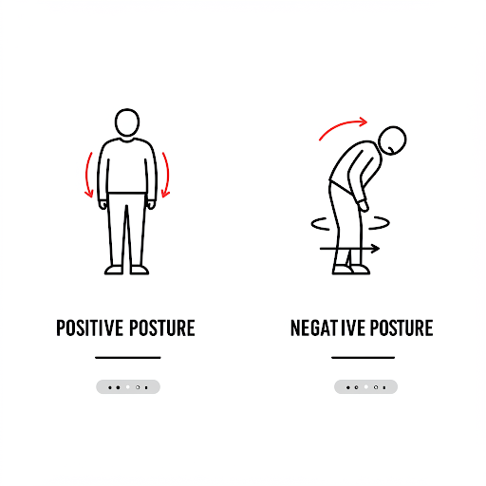
Non-Verbal Communication
Body Language Matters
Tip: Maintain Eye Contact
Example: Eye contact during a customer sale.
Activity: Demonstrate good/bad non-verbal cues, participants guess meanings.
Notes:
Discuss how non-verbal cues affect perceptions. Lead activity as a fun guessing game.

Slide 6

Written Communication
Professional Emails & Reports
Tip: Be Concise
Example: Follow-up email after a sales meeting.
Activity: Draft an email for a given scenario (e.g. inventory update).
Notes:
Emphasize clarity in written communication. Share a sample email, guide activity, review drafts.

Slide 7

Presentation Skills
Engage Your Audience
Tip: Use Stories
Example: Presenting sales targets to staff.
Activity: Deliver a 3-min presentation on a mock topic.
Notes:
Teach structure (intro, body, close). Assign topics (e.g., new store promo), provide feedback.

Slide 8

Conflict Resolution
Resolve Disputes Effectively
Strategy: Stay Calm, Find Solutions
Example: Handling a team disagreement over sales territories.
Activity: Role play a conflict scenario.
Notes:
Outline steps (listen, clarify, resolve). Provide scenario, facilitate role play, debrief on outcomes.

Slide 9
Conclusion
Key Takeaways
Apply Your Skills!
Q&A
Notes:
Recap topics, encourage practice in daily tasks, open floor for questions.

